Slide 1
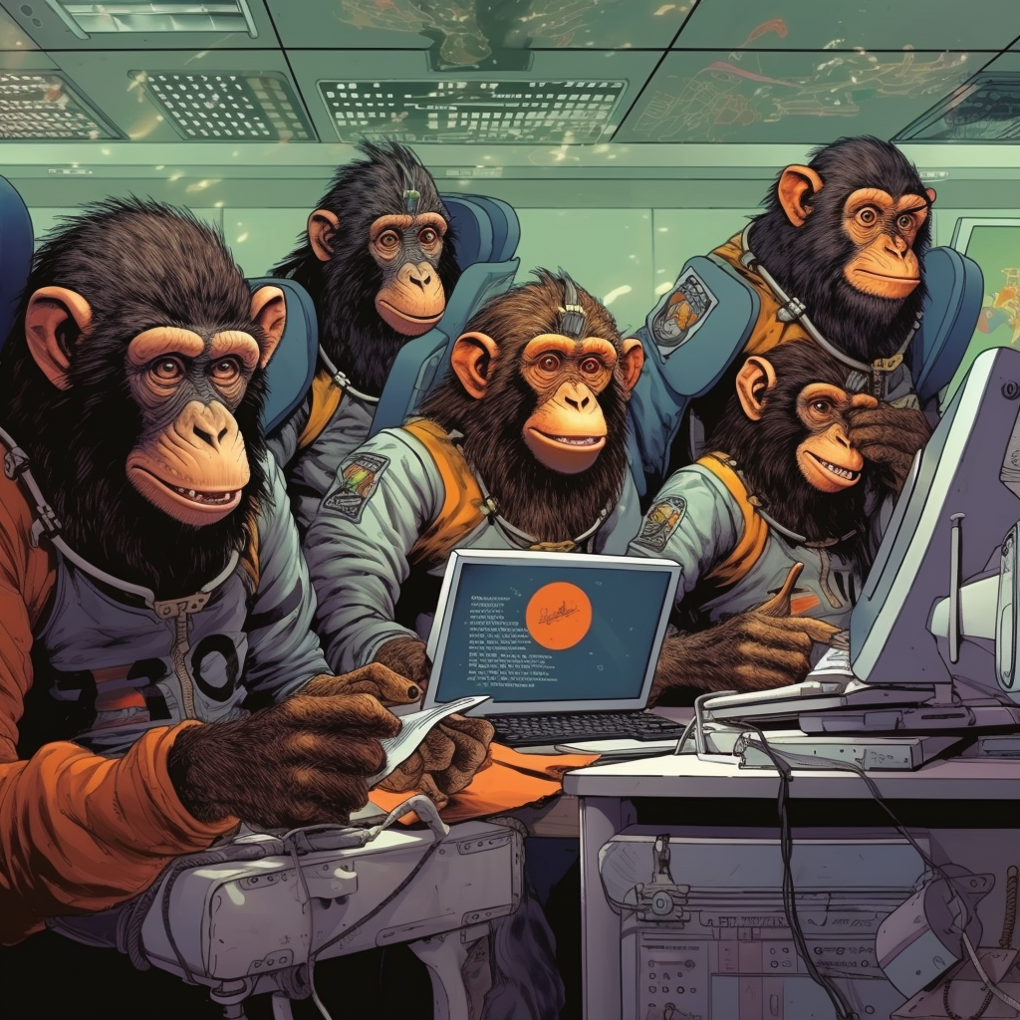

Space Chimps Deeplink Generator
Presented by Oli
#team-tv-space-chimp

Slide 2

What we do
Provide the ‘Off Product Catalogue’ to external partners such as Amazon, Google, Sky and others.
Provide the ‘Off Product Catalogue’ to internal partners such as Search and R&D.
Provide an open endpoint for messaging links, used by Google A5 and Sky Glass.
Maintain the Amazon Alexa Skill.
Provide schedules to partners.

Slide 3
What issue are we solving?
Marketing and editorial had to send human generated links to content.
Partners would occasionally receive malformed deep/messaging links.
This would cause errors and not take a user to the desired content.
Notes:
Due to the number of partners and different link type Editorial/Partner Marketing would occasionally send links to partners that were invalid.

Slide 4
What’s the solution?
Create a ‘non-dev’ friendly tool, that can create partner specific deep links with valid paths and query parameters for:
Amazon Intents
Deep Links
Shallow/Messaging Links
Notes:
Although JSON is great for developers, it’s not really user friendly, colleagues in partner marketing and editorial may not have the skills to parse through it.

Slide 5


How we built it?
Integrate the tool into current off product inspector tooling.
Use Next.js’ server side rendering and dynamic routes to determine the pid to generate deeplinks for, e.g. (/deeplink/b006m86d).
If the chosen pid is not a TLEO then redirect to brand on the server side.

Slide 6

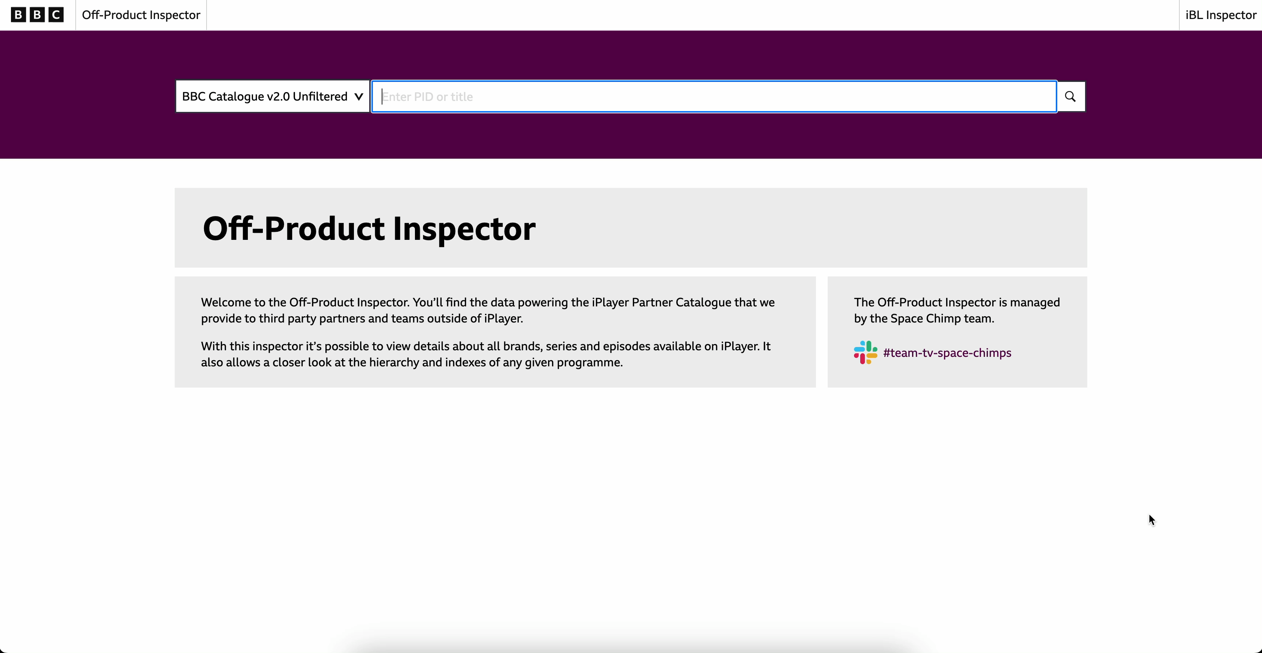
Demo

Slide 7
Additions for the future
Add CRUD (Create, Read, Update, Delete) functionality to be able to edit the deeplinks without re-deploying.
Create deeplinks for promotional collections e.g. (iPlayer Recommends).

Slide 8

Thank You Questions?

